Slide 1
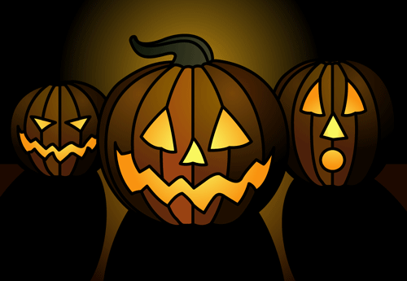

A Trio of Terror!
The Witch Head Nebula
The Ghost of Jupiter
The Medusa Nebula
Notes:
Presenting “A Trio of Terror!” or, “We Three Ghouls”, a devilishly special selection of three frighteningly good telescope targets for your Halloween viewing pleasure. Not for the squeamish. Not for the faint of heart. Not even necessarily for prime time either but here we go. Hold hands with the person next to you as we dare to visit the horrifying Witch Head Nebula, the haunting Ghost of Jupiter, and the terrifying Medusa Nebula.

Slide 2
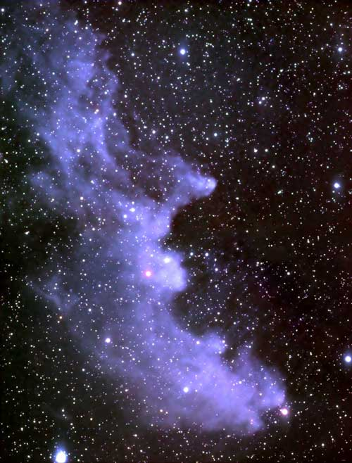
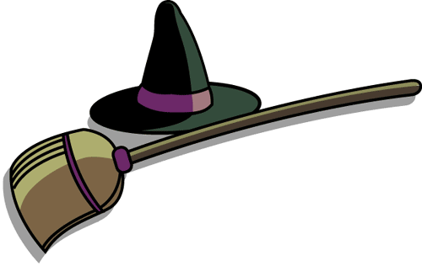
Notes:
Double, double toil and trouble; Fire burn, and cauldron bubble -- maybe Macbeth should have consulted the Witch Head Nebula. This suggestively shaped reflection nebula is associated with the bright star Rigel in the constellation Orion. More formally known as IC 2118, the Witch Head Nebula glows primarily by light reflected from Rigel, located just outside the top right corner of the above image. Fine dust in the nebula reflects the light. The blue color is caused not only by Rigel's blue color but because the dust grains reflect blue light more efficiently than red. The same physical process causes Earth's daytime sky to appear blue, although the scatterers in Earth's atmosphere are molecules of nitrogen and oxygen. The nebula lies about 1000 light-years away

Slide 3

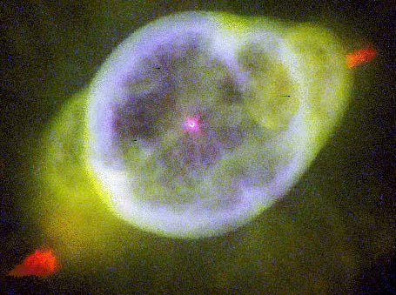
Notes:
The Ghost of Jupiter is one of the finest planetary nebulae for any fairly decent telescope and it is one of the most observed of the non-Messier listers. It is, of course, the death throes of a dying star. At 2800 ly away in, appropriately enough for Halloween, the constellation Hydra (the water monster) Jupiter’s Ghost is a.k.a. NGC 3242 and was discovered by William Herschel in 1785. We look through the spherical shell of outgassed, fluffed off material to see the central star. It is almost literally true that the minimum requirements to detect are any telescope under urban skies and it is one of the AL’s 100 Urban Club objects. I logged an observation of the Ghost of Jupiter on April 19, 2003 at 2141 hours EST when the weather conditions were “Fairly clear. Occasional thin wispy clouds but not really an impediment. 46-48 degrees.” The observation notes read:
“Backyard setup adjacent to Bluebird Observatory. The Ghost of Jupiter, or the Eye, is a planetary nebula that rewards high power. TeleVue Nagler 9mm, 61x is enough to reveal it clearly but doesn't begin to show the structure. Blue color evident. Hard to mistake this object for Jupiter, though. The Ghost is one of two objects in Hydra that are part of the Urban Astronomy Club. Fairly easy walk down from Alphard to Lambda Hydra and then to the Ghost of Jupiter.”

Slide 4
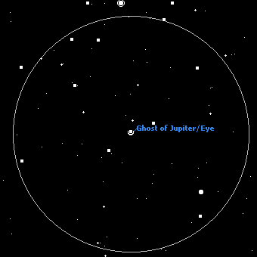

The view in a 6-inch at 50x. North is down, east is right.
Notes:
So let’s get real my friends. Unless you are observing with the fine instruments made by Meade or TeleVue like all four of mine are you won’t be seeing the Hubble-like image as in the previous one. Instead you’ll be stuck with this view in a typical 6-inch at 50x. Now it looks much more like Jupiter! But like most bright planetary nebulae (and the Ghost of Jupiter is magnitude 8.60) the Ghost appears pale blue or green to the eyes of most observers. The Ghost of Jupiter is, appropriately enough for Halloween, in the constellation Hydra.

Slide 5

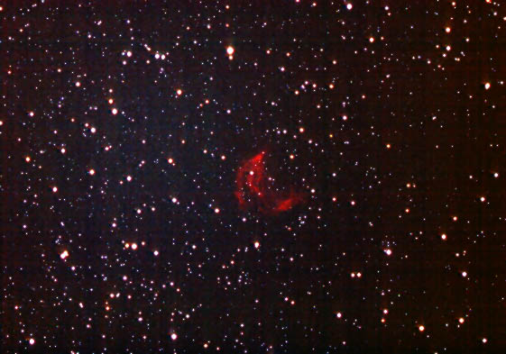
Notes:
“And they are three, the Gorgons, each with wings
And snaky hair, most horrible to mortals,
Whom no man shall behold and draw again
The breath of life”
-----Appollodorus
Medusa was one of three gorgons; grotesque, extremely powerful creatures with large wings and bodies covered with yellow scales. Medusa’s hair was a mass of living snakes that partially hid a face so hideous that all who gazed upon her would be turned to stone in a blink of an eye.
“Of terrible Medusa,
When wandering through the woods she turned to stone
Their savage tenants; just as the foaming Lion
Sprang furious on his prey, her speedier power
Outran his haste,
And fixed in that fierce attitude he stands
Like Rage in marble!”
-----Invitations of Shakespeare [Armstrong]
On a clear, dark night the Medusa Nebula seen here is a reasonably easy find in Gemini using a 6-inch reflector, a 50x wide angle eyepiece and an O!!! Filter. It is a crescent shaped planetary nebula and nearly as large as the Helix Nebula, so it is best to use low poer, wide field, and a good nebula filter. Even then the night and the gorgon has to be accommodating or it will not appear.
As Richard Orr has elsewhere said, “In the early morning hours of Hallows Eve when we relive the spirit world of times long passed, the Medusa ghost is high overhead. Take a look through your own telescope at her and, if conditions are right, the slight shifting of air cells in the upper atmosphere will make her unearthly hair dance like a thousand snakes.”

Slide 6
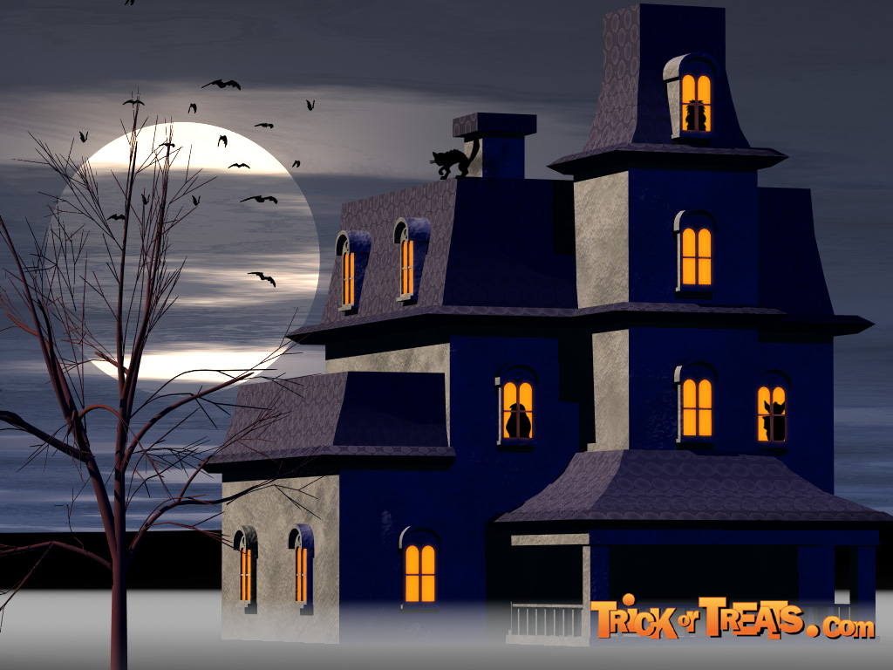
Notes:
And so seek out this season if you dare this trio of terror: the Witch Head Nebula, the Ghost of Jupiter, and the Medusa Nebula. Such an experience this time of the year when much is not plainly in evidence and doubts are mounting in your heart, if you survive it at all, reinforces the not so comforting thought that much of the universe is still mysterious and beyond our current understanding.

